Slide 1

An Introduction to Salesforce Admin
Authored by :Saurabh Kumar

Slide 2
Agenda
Force.com Declarative Development
Basic Salesforce Architecture
Company Overview (Organization Setup)
Salesforce User
Standard and custom Salesforce object.
Salesforce Object Relations
Activity management
Data Management
Workflow
Approval process
Process builder
Visual Flow
Assignment rule
Chatter
Sales and marketing application
Service and support application
Security and Access

Slide 3
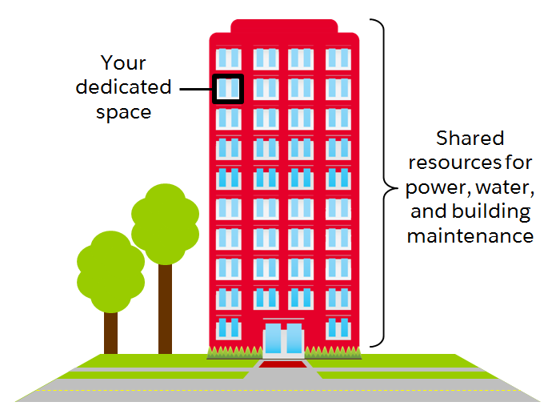
Multitenant Structure

Slide 4
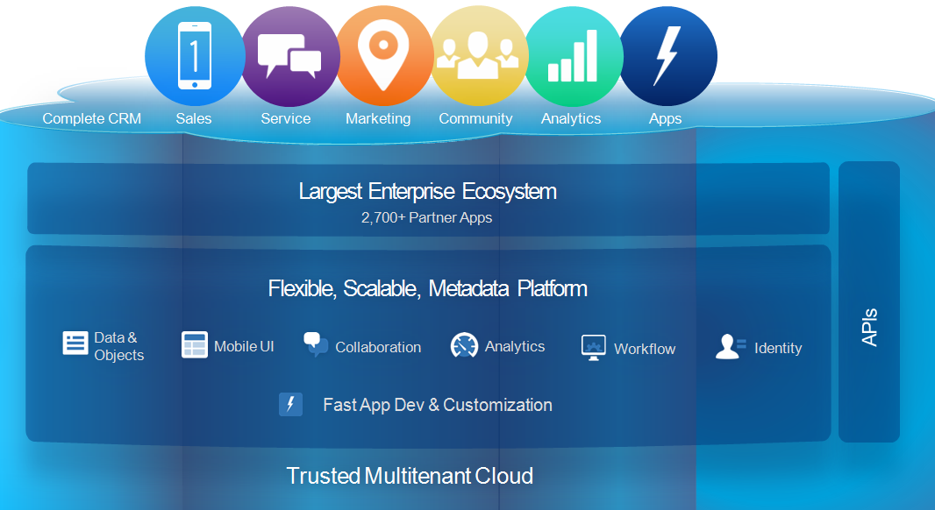
Multitenant Structure

Slide 5
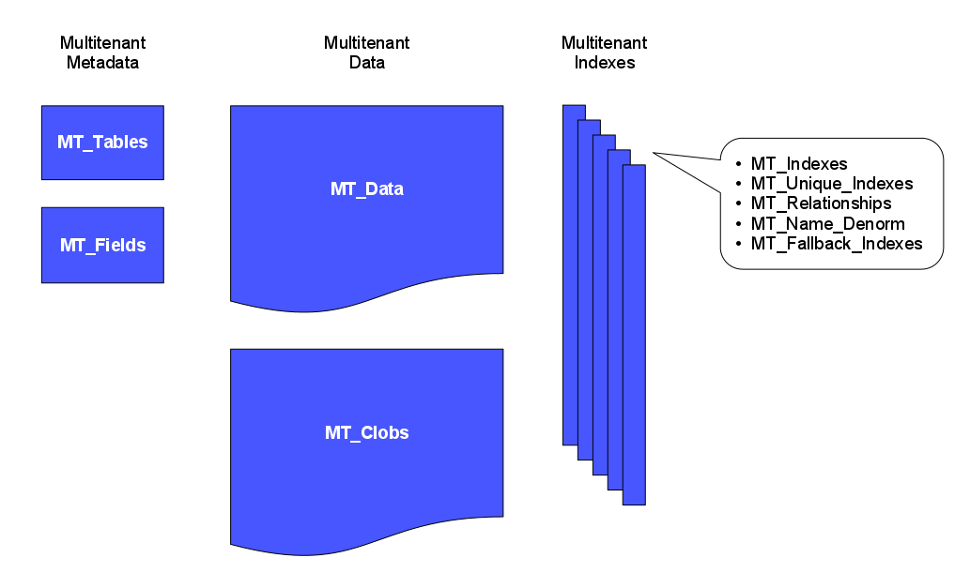
How Salesforce is Multitenant

Slide 6
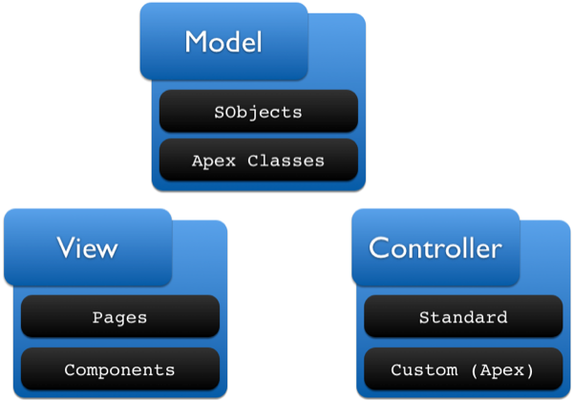
The Model, View, Controller Paradigm

Slide 7
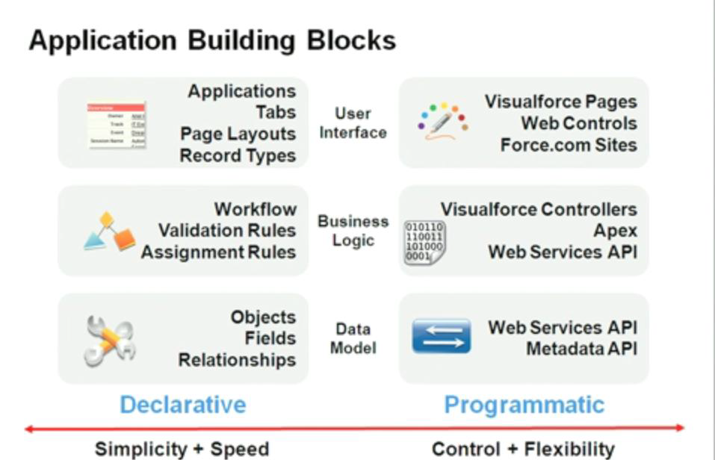

Slide 8
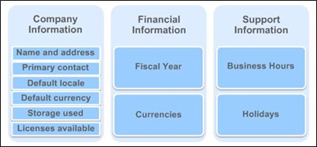
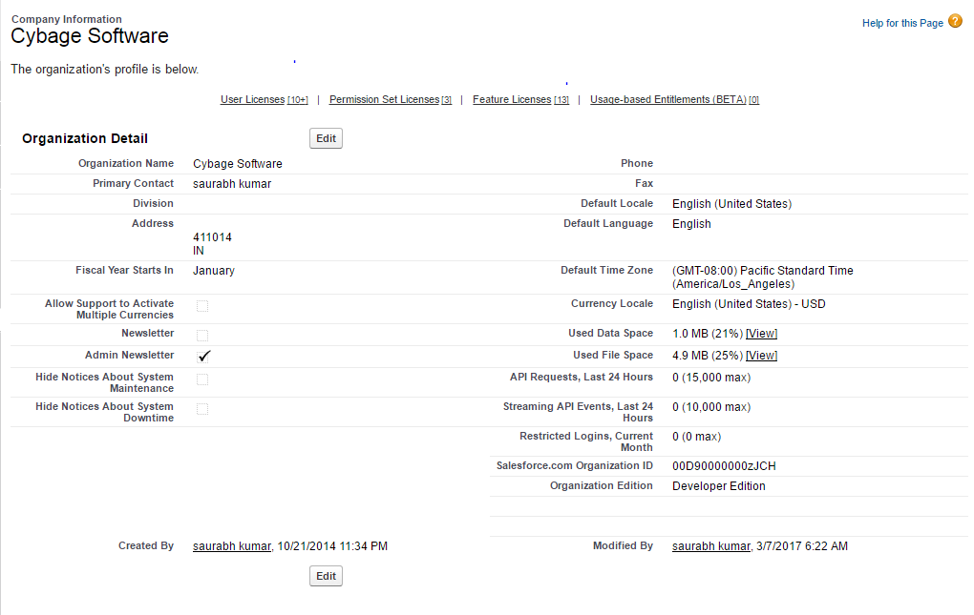
Organization Setup (Company Overview)

Slide 9
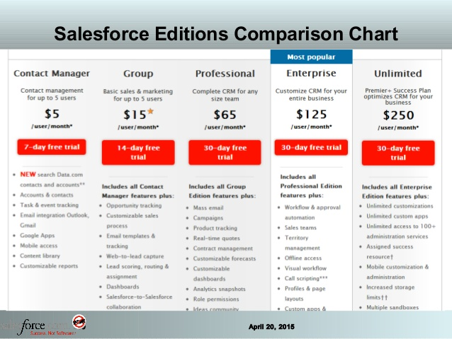
User License

Slide 10
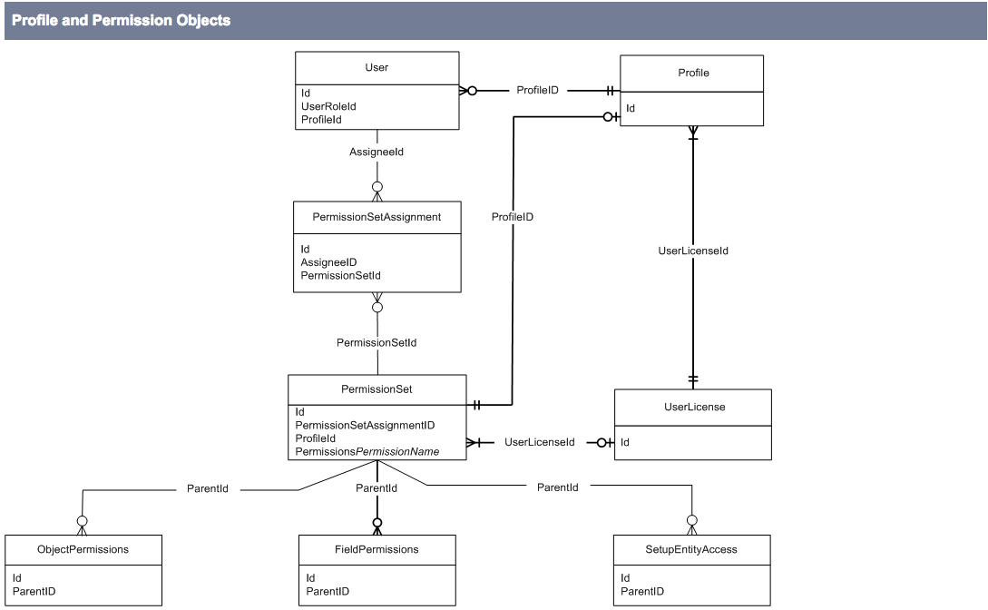
User And Profile

Slide 11
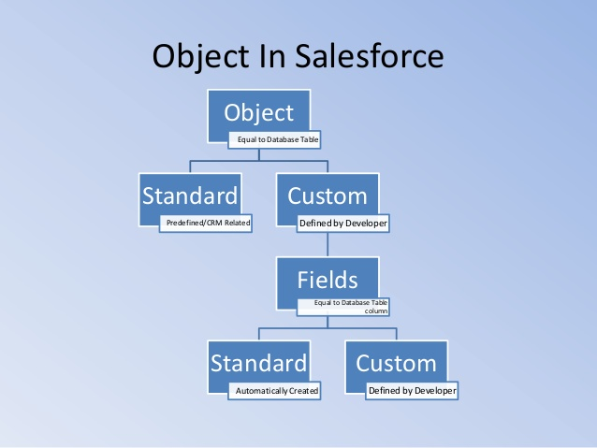
Standard And Custom Object

Slide 12
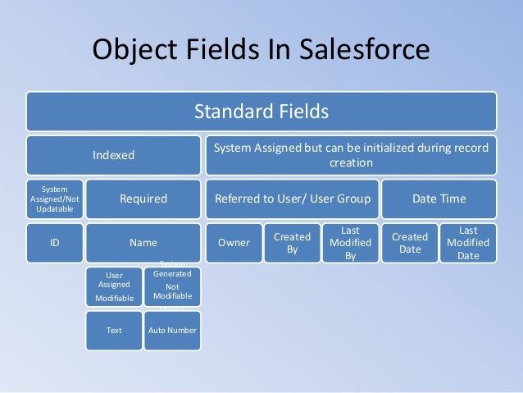
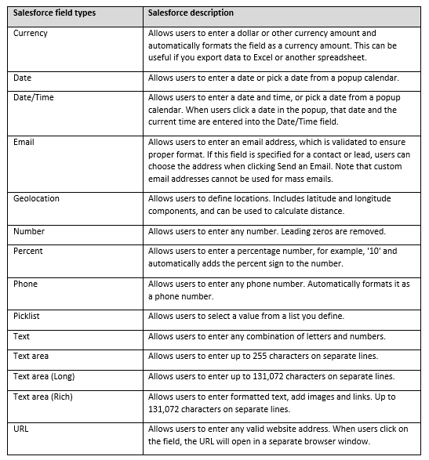
Standard And Custom Field

Slide 13
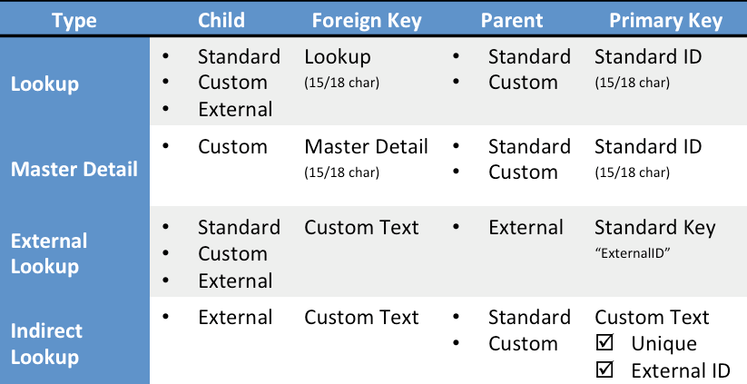
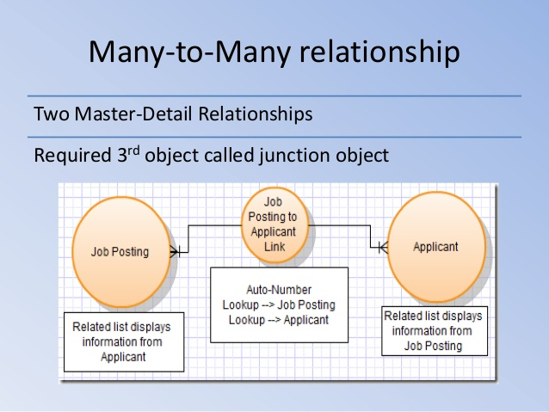
Salesforce Object Relations

Slide 14
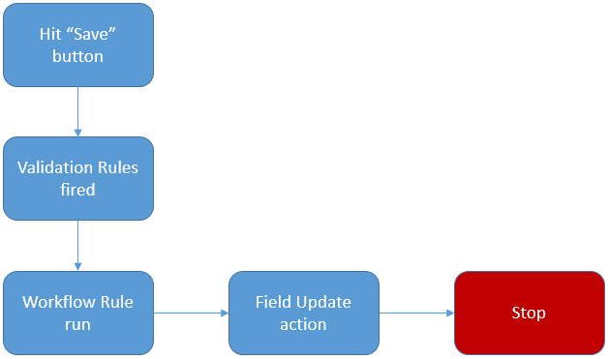
Validation Rule
Validation Rules Fire just after DML

Slide 15
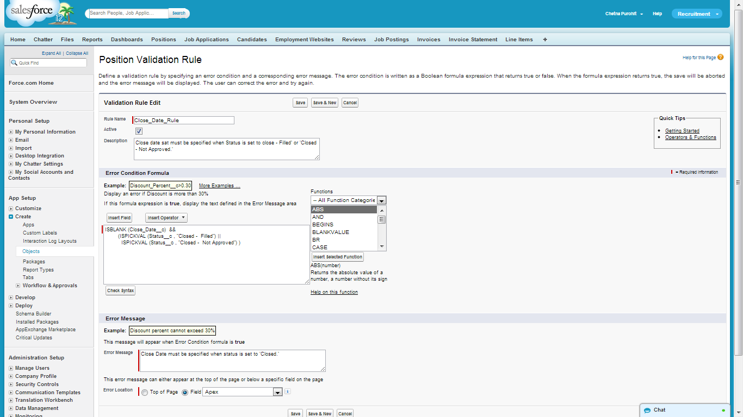
3. Using Formula and Validation

Slide 16
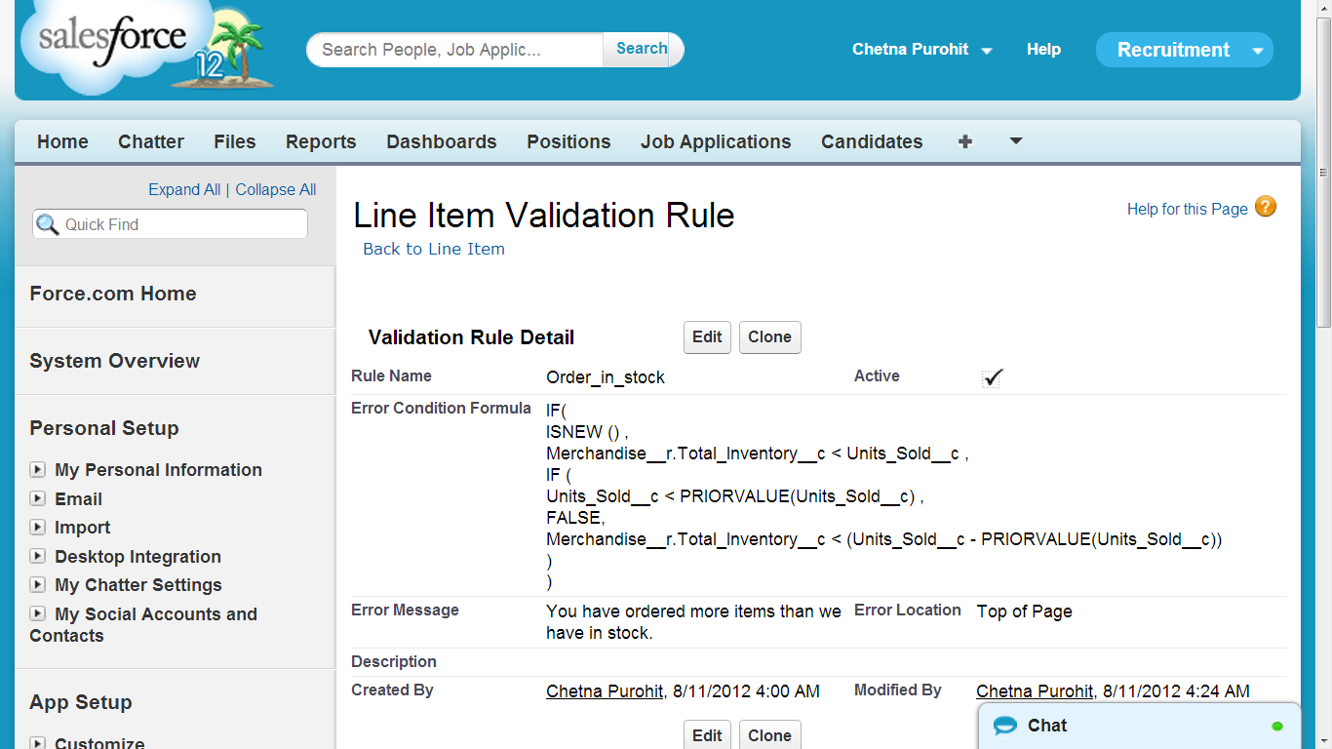

Slide 17
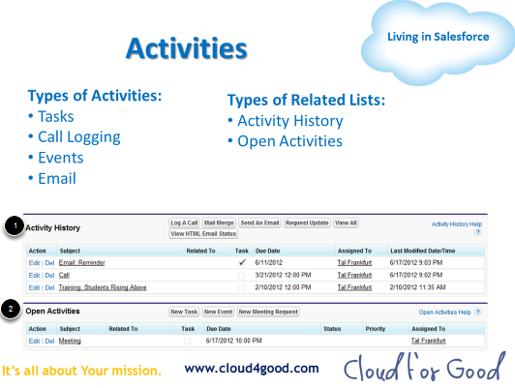
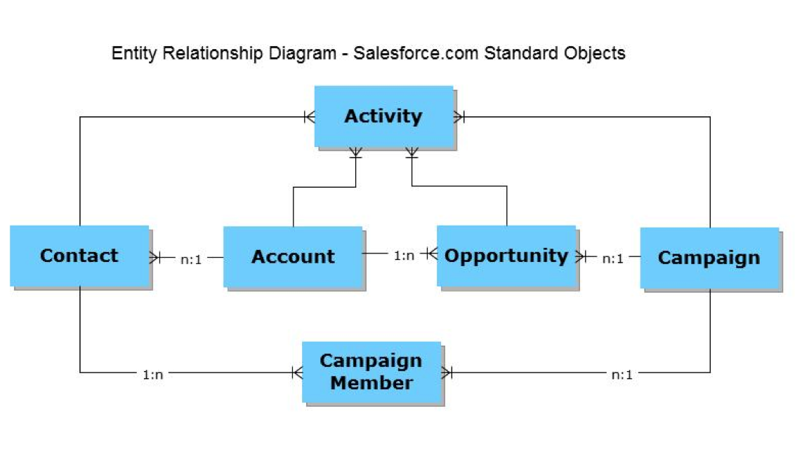
Activity Management

Slide 18
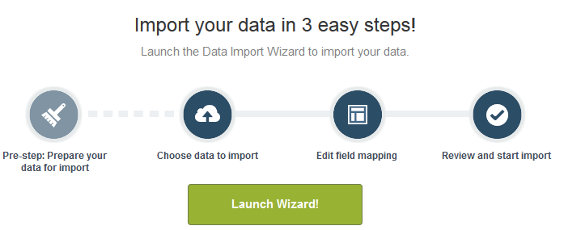
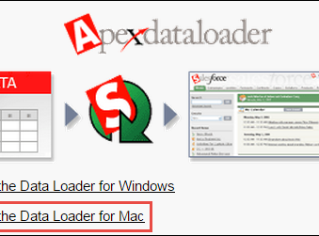
Data Management
Salesforce Import Wizard
Apex Data Loader

Slide 19
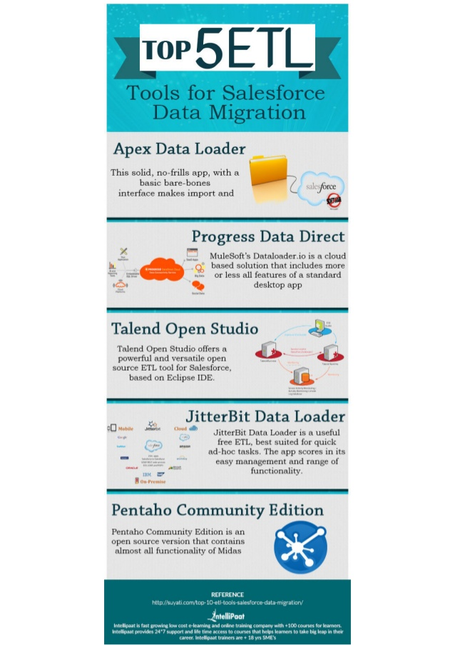
Other Data Management Tool

Slide 20
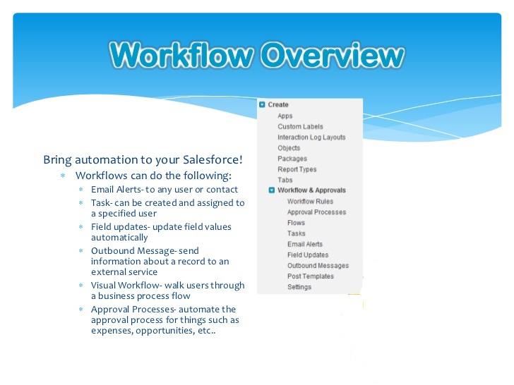
Workflow in Salesforce

Slide 21
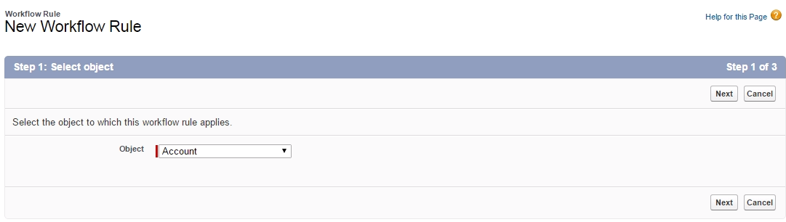
Steps to Create Workflow
Step 1 : Select Object

Slide 22
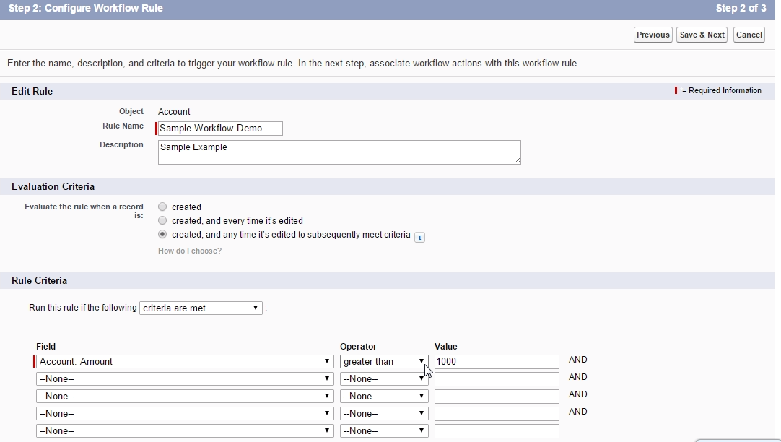
Step 2 : Defining criteria

Slide 23
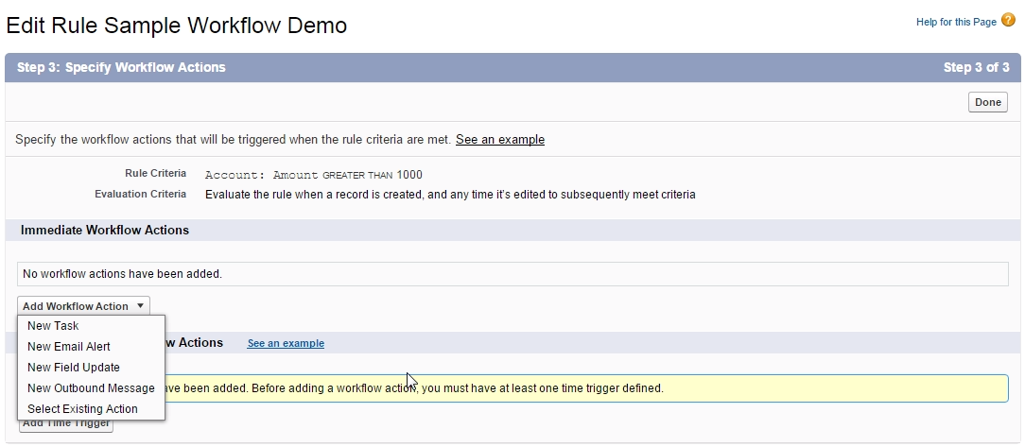
Step 3 : Select action

Slide 24
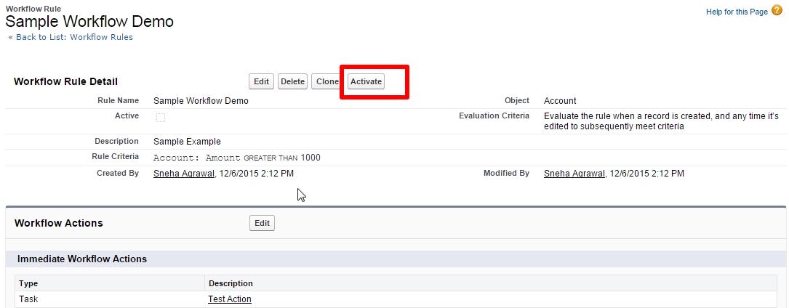
Step 4 : Activate workflow

Slide 25
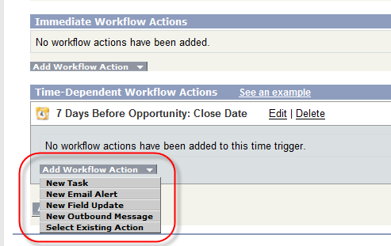
Time Based Workflow

Slide 26
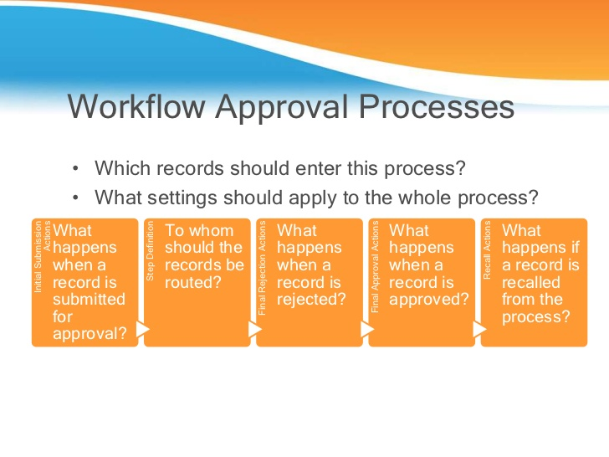

Slide 27
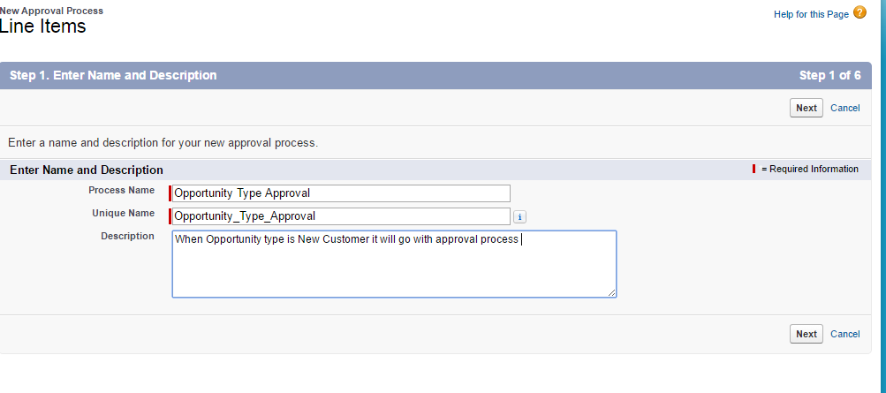
Create Approval Process
Navigate setup->Create ->Workflow & Approval ->Approval Processes
Click on Create New Approval process and choose new standard Setup Wizard From drop down list
Step 1:-Enter Name

Slide 28
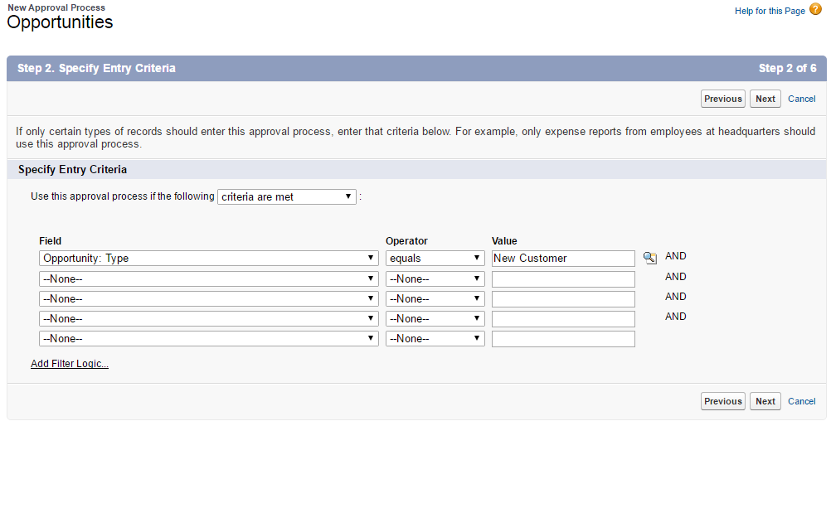
Step 2 : Specify Entry Criteria

Slide 29
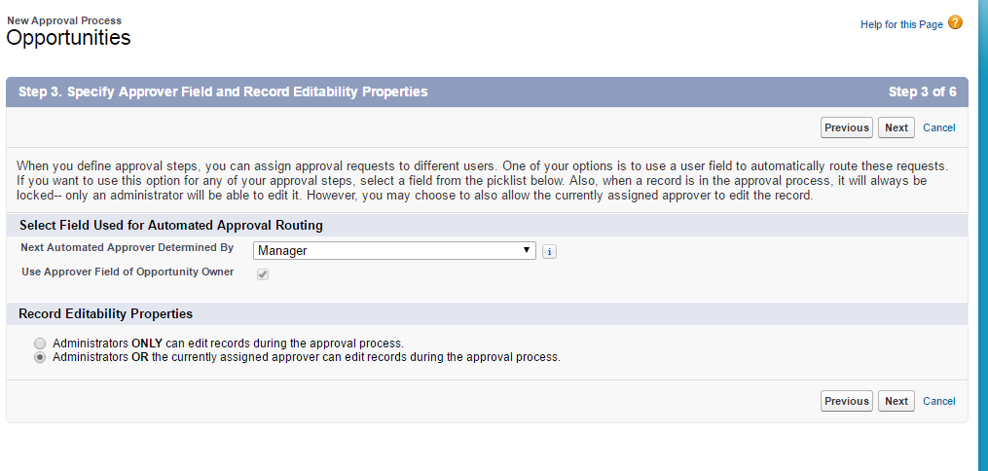
3.Specify Approver Field and Record Editability

